Slide 1
Red Team
Las Torres

Slide 2
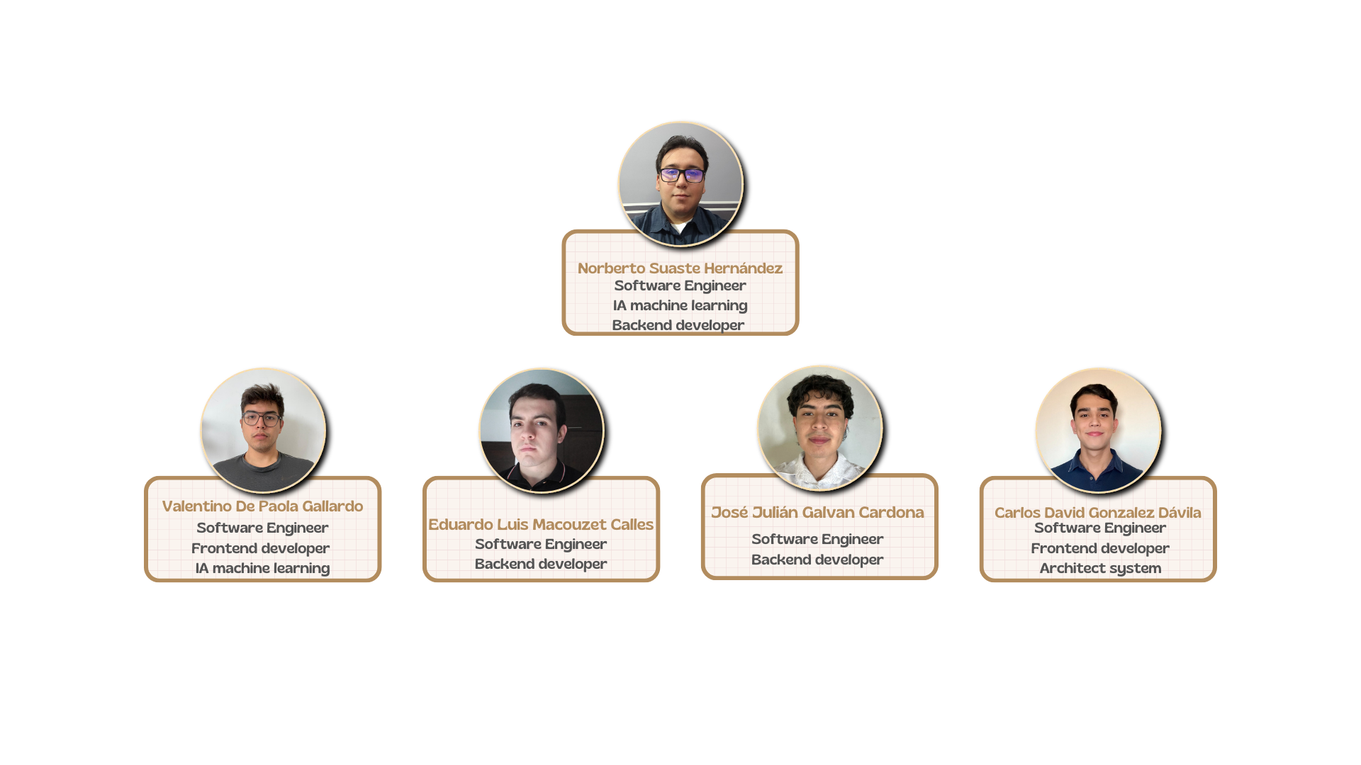
Team members

Slide 3
System Documentation & Architecture
Functional requirements:
Automated profile analysis.
Candidate prioritization.
Recruiter-friendly interface.
Continuous feedback and learning system.
Comprehensive report generation.
Technical requirements:
Natural Language Processing (NLP).
Machine Learning models.
Robust infrastructure and data storage.
Advanced security and compliance measures.
Intuitive UI/UX design.
Performance metrics and system evaluation.
Notes:
Our system is designed with five key functionalities: it automatically analyzes candidate profiles, prioritizes candidates based on their potential, provides an intuitive interface for recruiters, supports continuous model improvement via feedback, and generates detailed reports to guide decision-making.
On the technical side, we’re leveraging NLP and machine learning to process and analyze candidate data effectively. Our infrastructure is built for scalability and security, ensuring compliance with privacy standards. An intuitive UI/UX enhances the user experience, while built-in performance metrics allow continuous system evaluation and improvement.
This overview covers the first part of our project. In the upcoming sections, we'll dive into additional aspects that further detail our innovative recruitment solution.

Slide 4
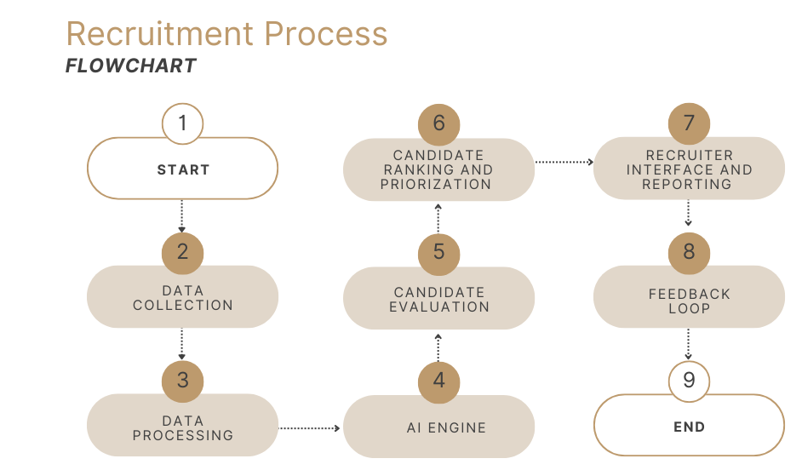
System Documentation & Architecture

Slide 5
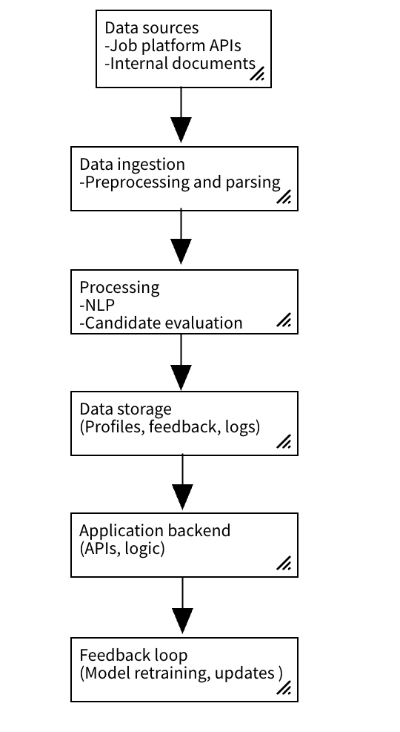
System Documentation & Architecture
Notes:
Data Sources & Ingestion: Our architecture begins with diverse data sources, which feed into an ingestion layer where data is cleaned, standardized, and parsed. Processing Layer: The core processing layer utilizes NLP for feature extraction and ML models for candidate evaluation. This is where the real analysis happens. Data Storage: "All processed data, including candidate profiles, evaluation results, and feedback, is securely stored."Backend & Interface: An application backend handles business logic and exposes APIs, while an intuitive dashboard provides recruiters with real-time insights and comprehensive reports. Feedback Loop: A dedicated feedback module captures recruiter input, enabling continuous retraining and improvement of our ML models.

Slide 6
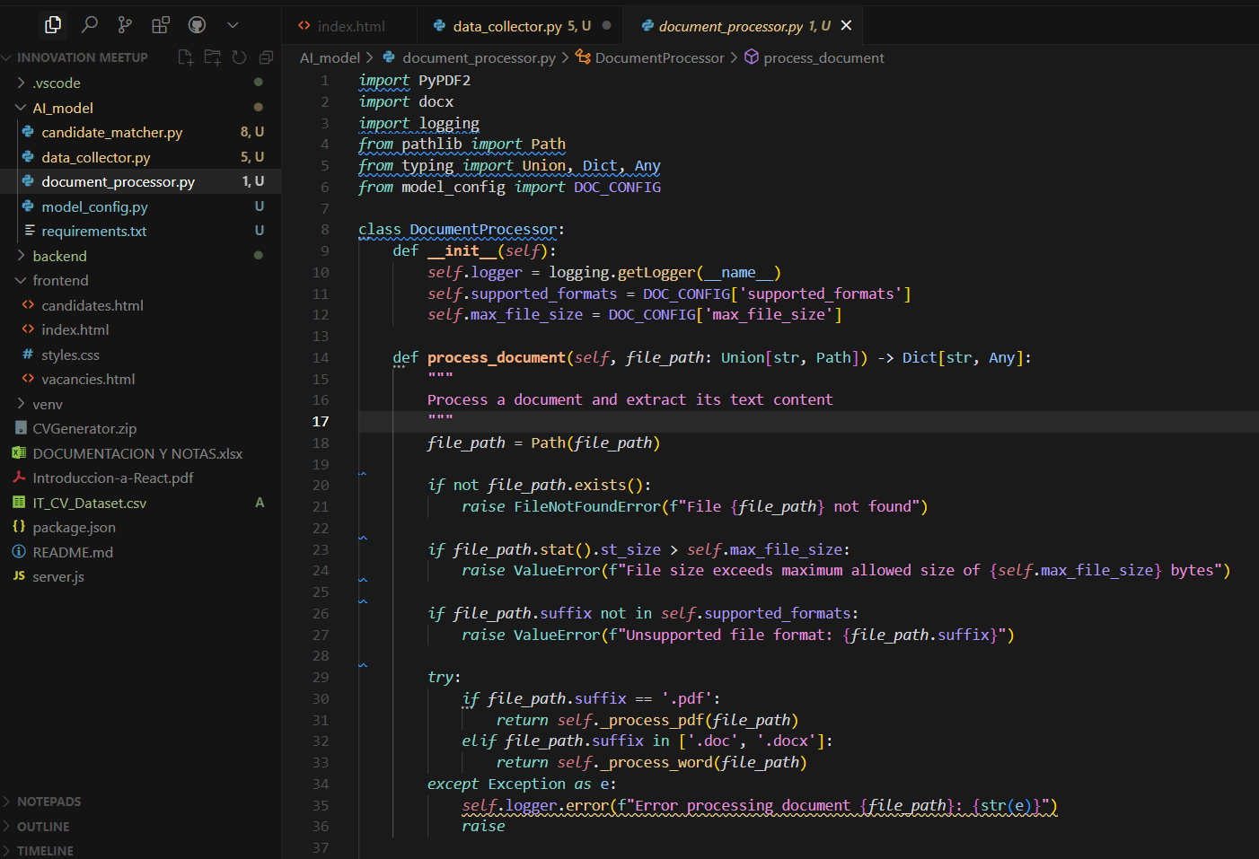
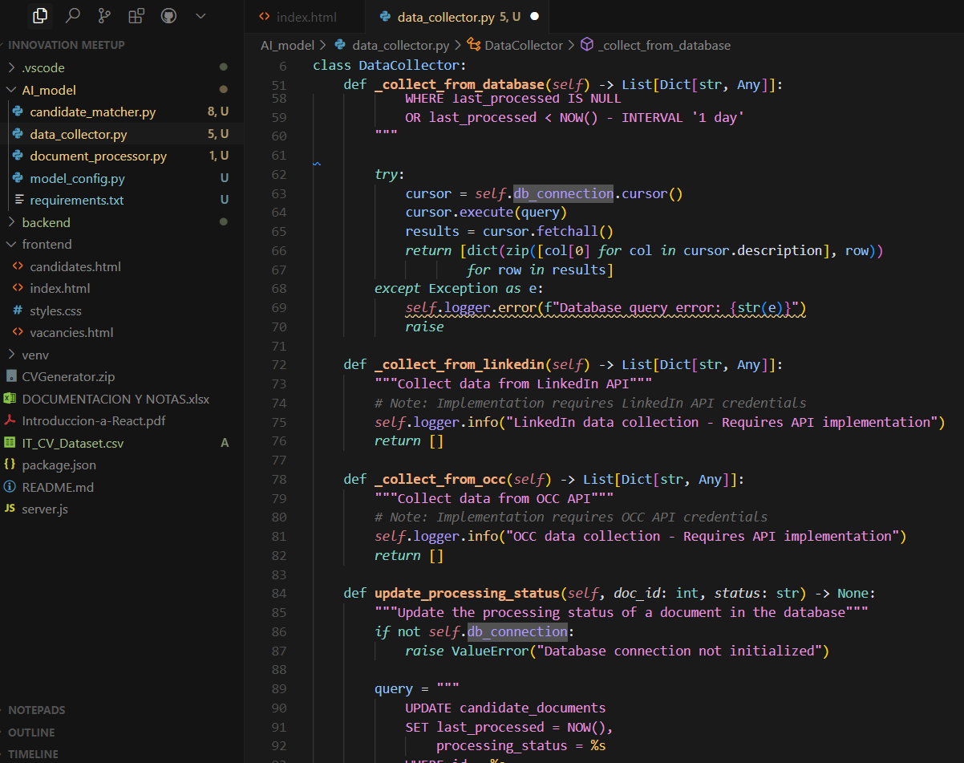
AI Model Development
How is the information collected?

Slide 7
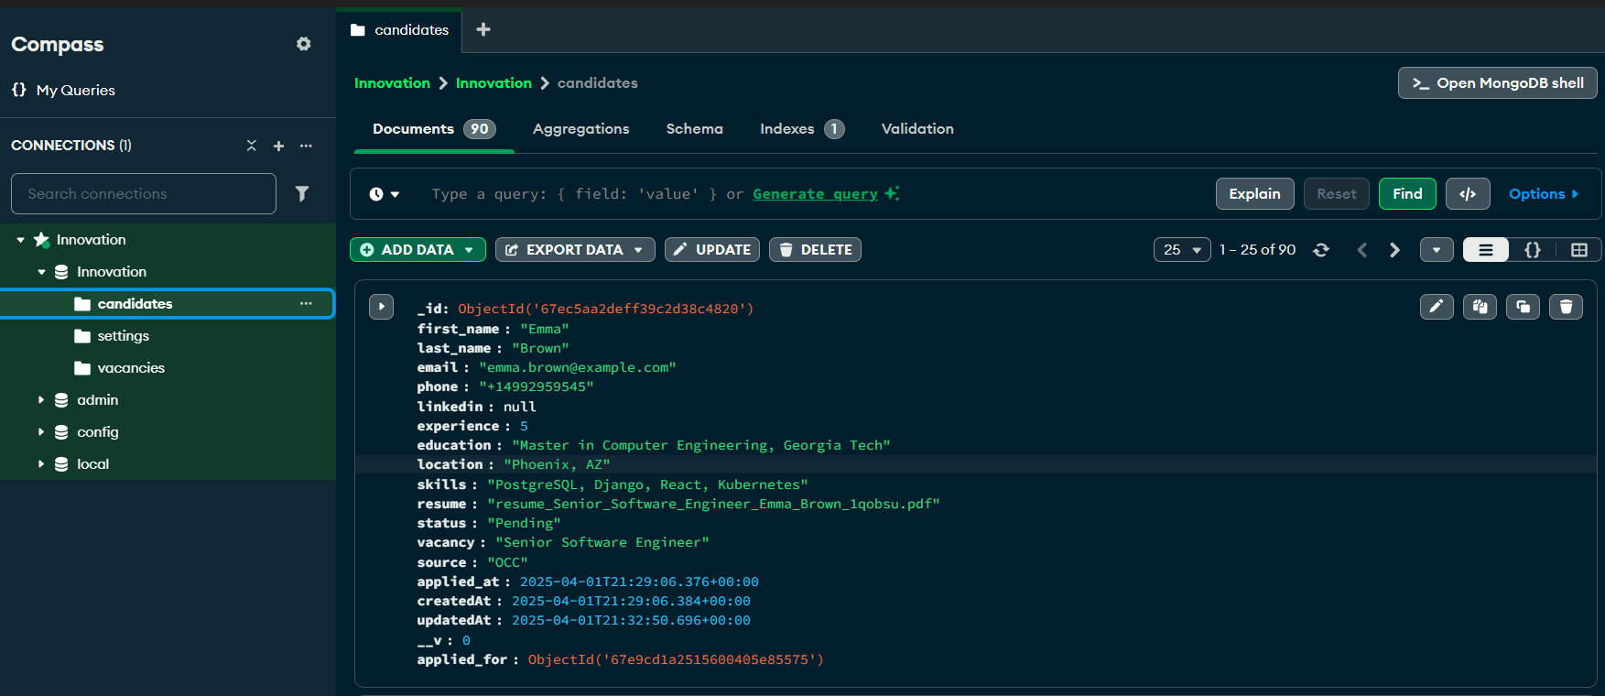
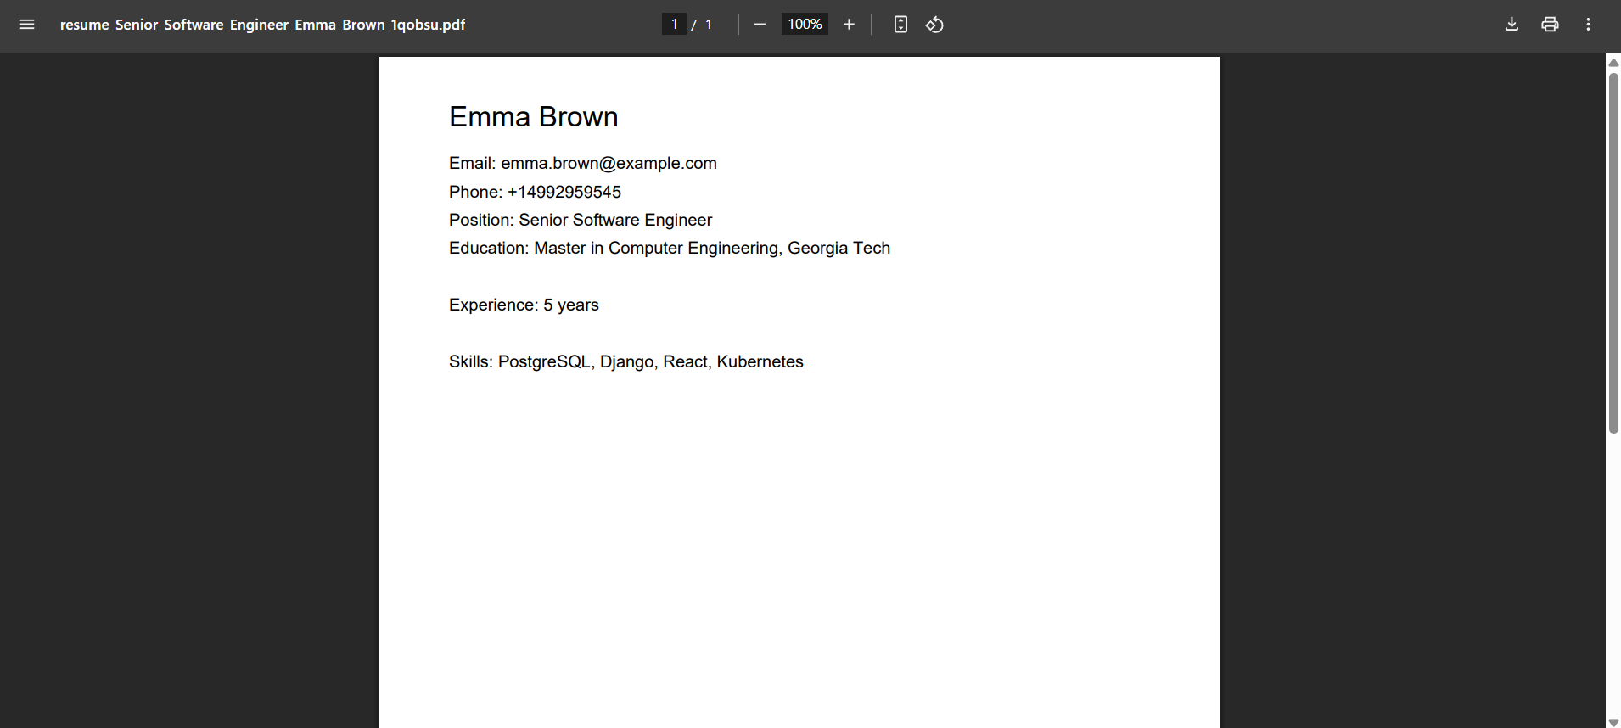
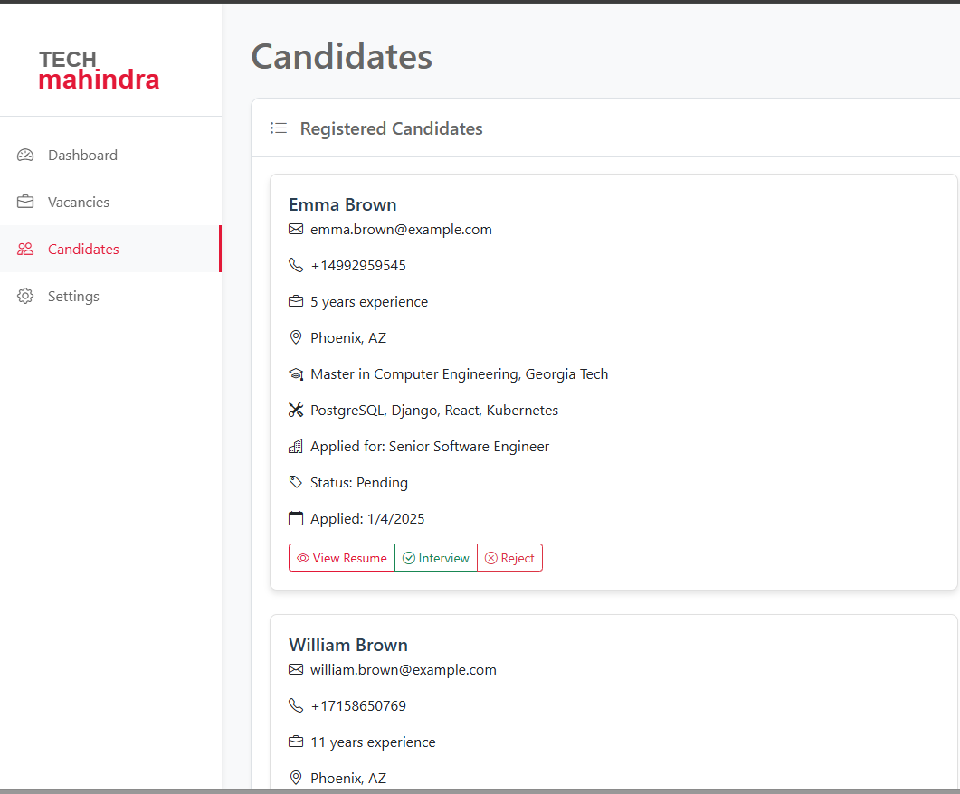
Data Source Integration
How information is going to be integrated:

Slide 8
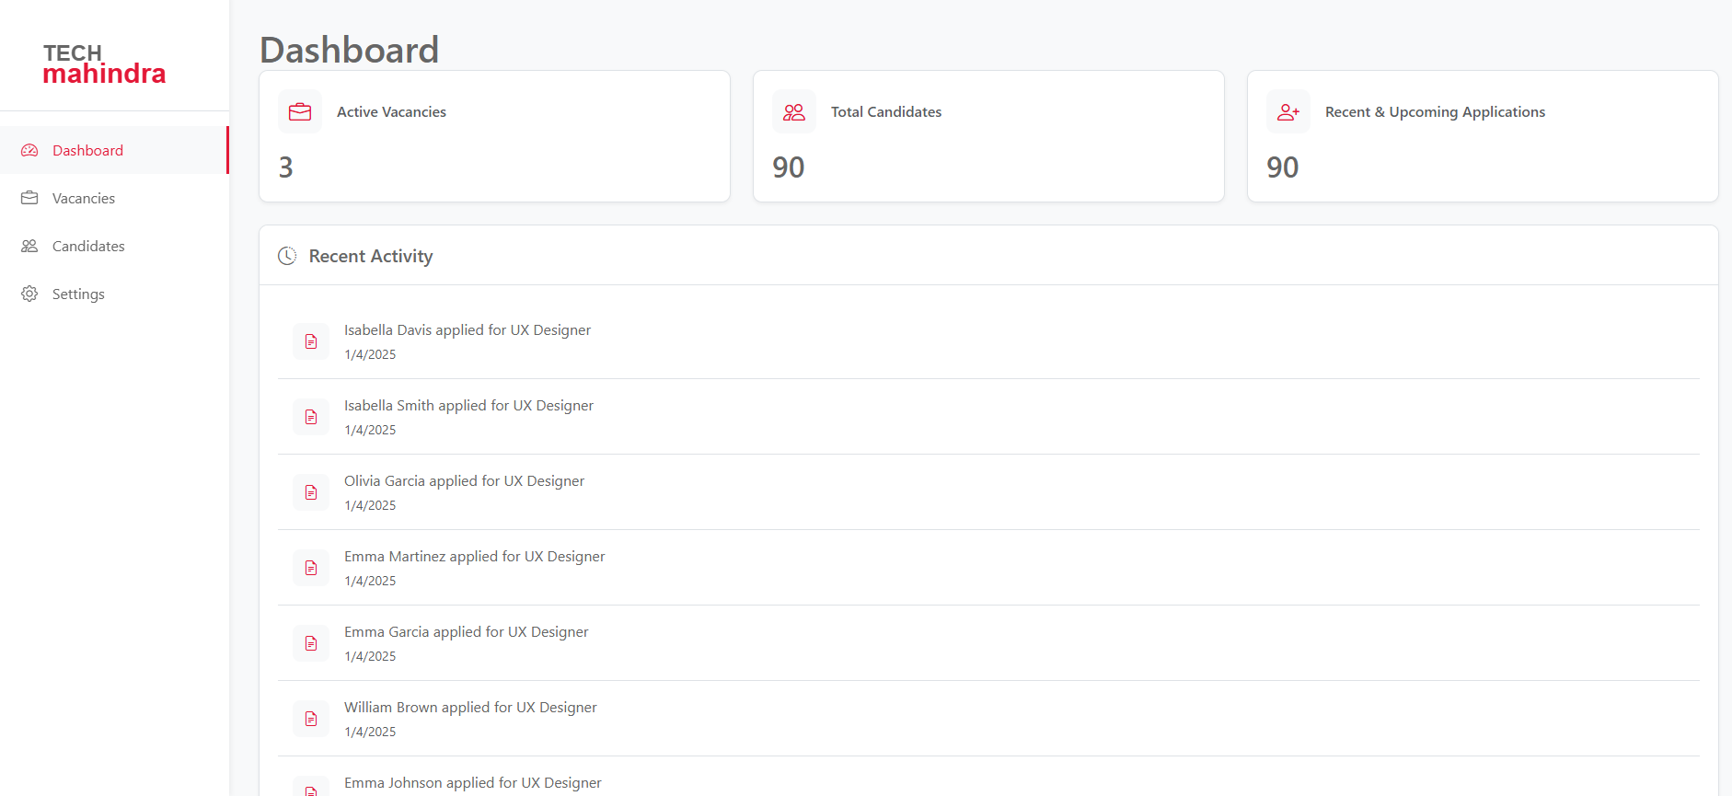
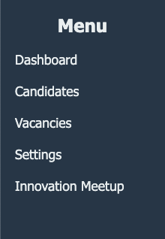
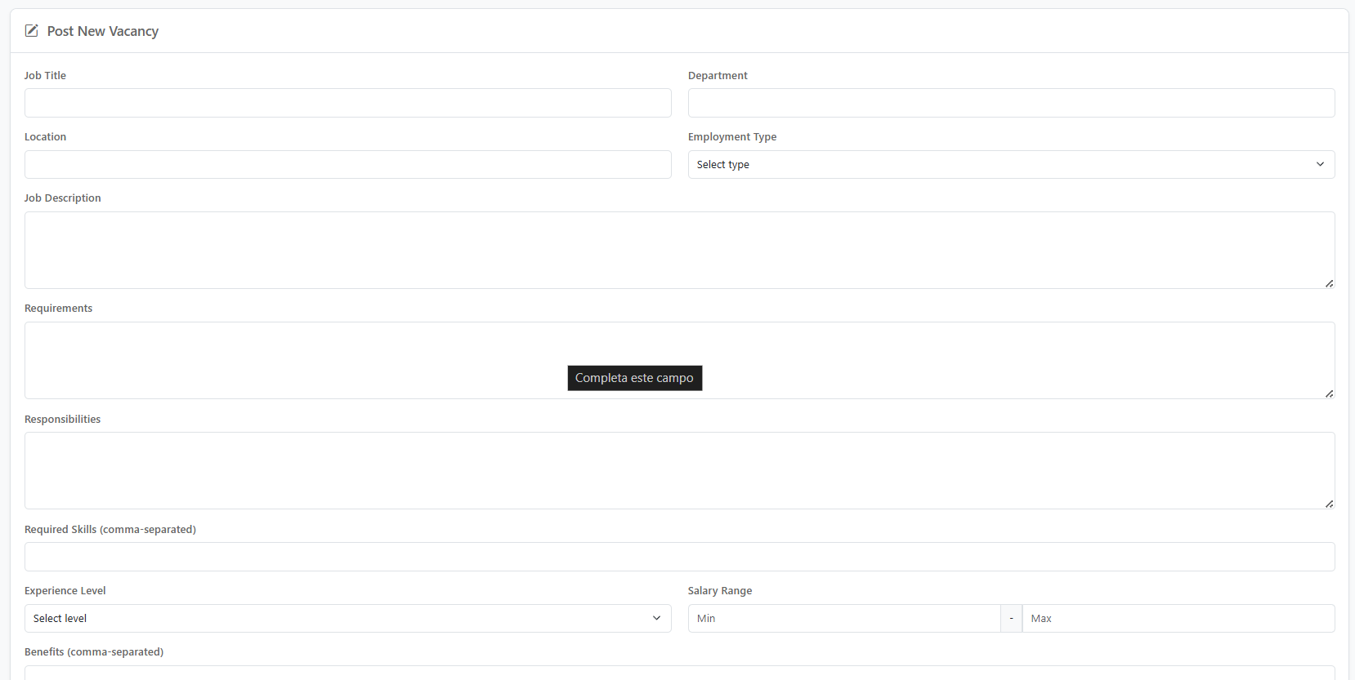
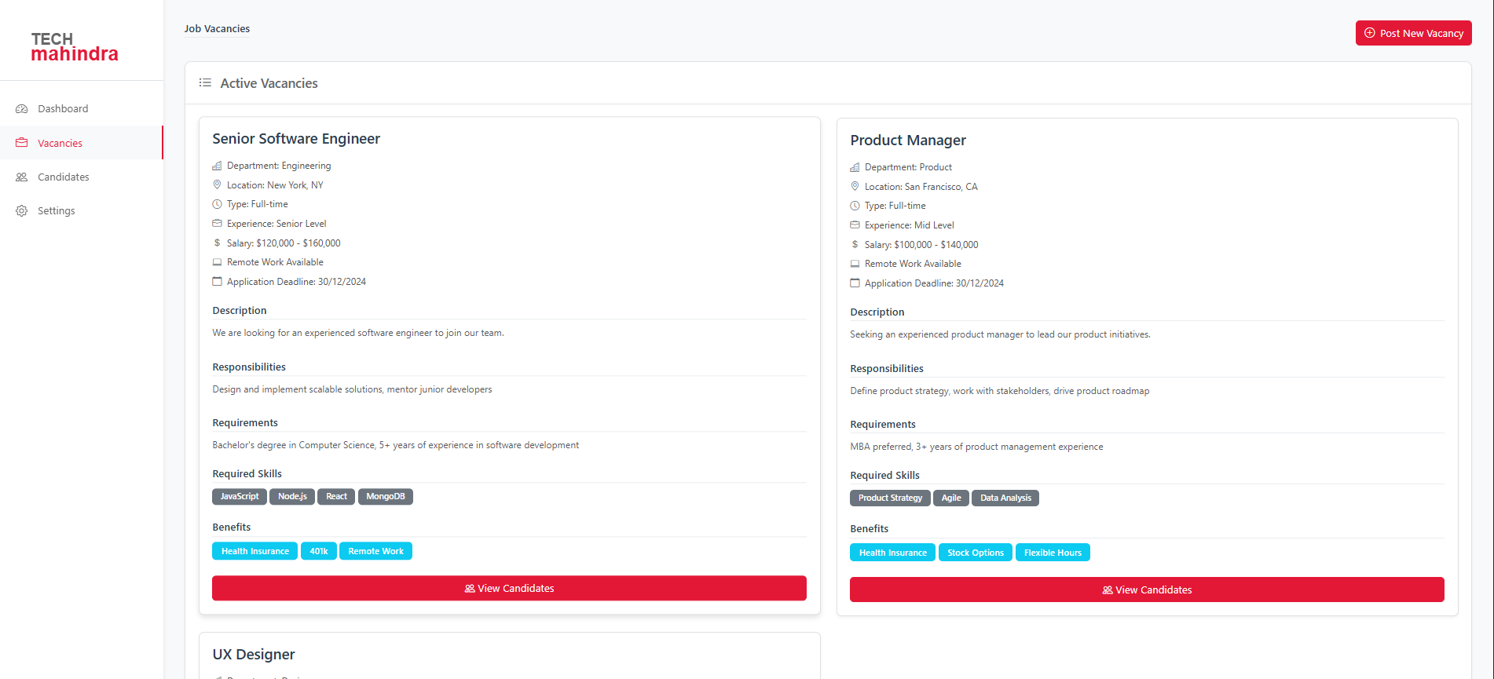
Functional Prototype

Slide 9
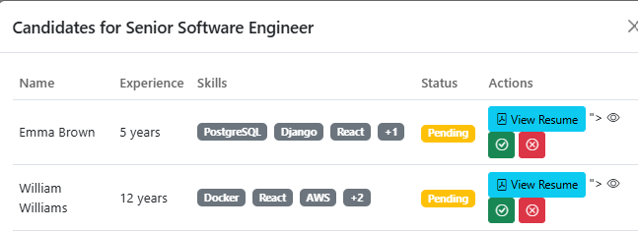
Testing & Error Resolution
Pilot Test Report:
Error 1: Embeddings generated incorrectly due to an issue in tensor normalization.
Error 2: Data collection failure due to an incorrectly configured refresh interval.
Error 3: PDF document processing failed when the file contains images.
Bug 1:
Incorrect Embedding Normalization
Symptoms: The generated embeddings are inconsistent, affecting the accuracy of matching.
Cause: Embedding normalization is not done correctly after generation.
Solution: Normalize embeddings before calculating cosine similarity.
Bug 2:
Incorrectly Configured Refresh Interval
Symptoms: Data is not updated according to the configured interval.
Cause: The refresh interval is not applied correctly in the data collection logic.
Solution: Fix the logic of _should_refresh to respect the configured interval.

Slide 10
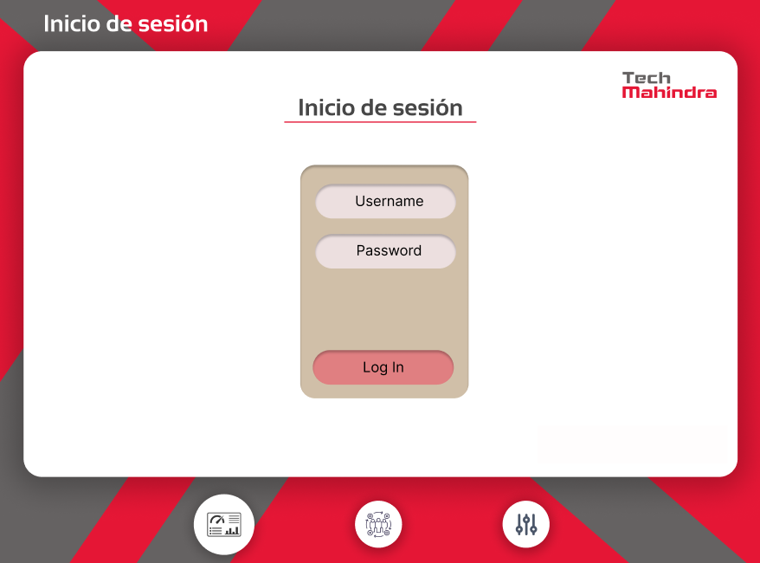
Secure Deployment
Secure Login System for HR Personnel
User Credentials
Username: Automatically assigned (e.g., hr01, hr02).
Password: Automatically generated (12 characters, includes uppercase, numbers, and special characters).
Encryption:
Passwords stored using bcrypt hashing.
Communication encrypted with TLS (HTTPS).

Slide 11
Project Plan
Project phases and key milestones:
Phase 1: Proposal & Planning (Week 1)
Project kickoff and requirements collection
Documentation and proposal presentation
Stakeholder validation and feedback
Phase 2: Development & Implementation (Weeks 2–4)
Week 2: Development planning, architecture design, and database setup
Weeks 2–3: Build the profile analysis module (NLP, OCR, API integration)
Week 4: Pilot testing, evaluation, and debugging

Slide 12
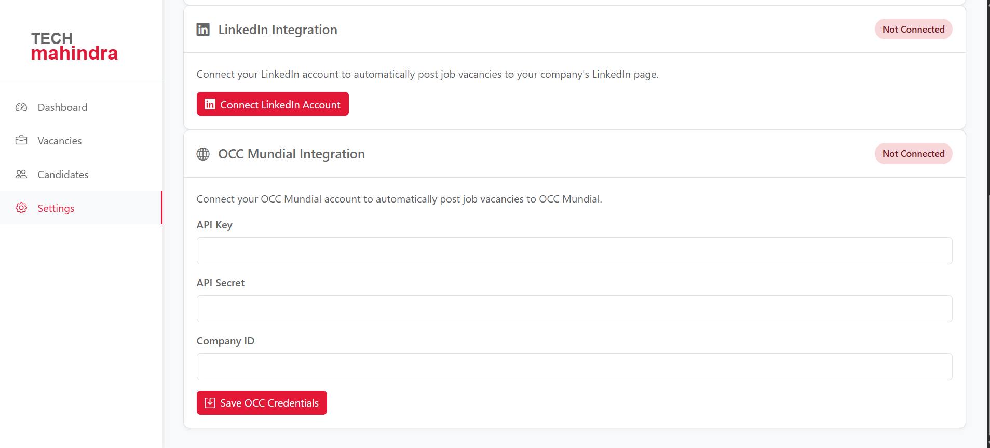
Project Plan
Technologies & Tools:
Programming & Frameworks: Python (Scikit-learn, TensorFlow), React.js
Database: MongoDB
Infrastructure: Private cloud servers
External APIs: LinkedIn, OCC
NLP & OCR Tools: SpaCy, Tesseract
Key Success Metrics:
Model accuracy and performance
Reduced candidate selection time
High HR satisfaction via feedback
Compliance with security and privacy standards

Slide 13
Feedback & Impact Assessment
Key Points to Cover:
How We Will Gather Feedback
Surveys and interviews with recruiters and hiring managers to assess usability and effectiveness.
Candidate feedback on fairness, transparency, and ease of the application process.
System performance monitoring to track accuracy, efficiency, and error rates.
Expected Performance Improvements
Reduction in manual effort for recruiters (target goal: X% decrease in review time).
Enhanced candidate-job matching accuracy (goal: X% improvement in successful placements).
Increased efficiency in filtering applicants (goal: process resumes in X seconds).

Slide 14
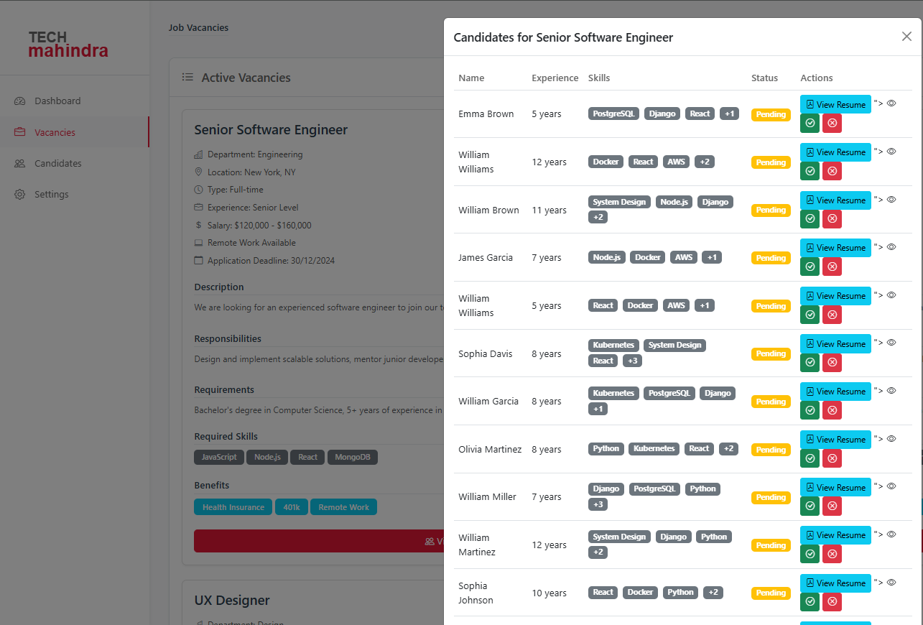
Conclusion & benefits
Our proposed AI recruitment system is designed to enhance hiring efficiency by reducing manual workload, improving candidate-job matching, and providing real-time insights.
Potential avenues for optimization or improvement:
Pilot Program Implementation: Conduct an initial test with a small recruiter team to gather early feedback.
Model Fine-Tuning: Adjust AI parameters based on recruiter feedback and hiring outcomes.
Integration with HR Systems: Enhance compatibility with existing ATS (Applicant Tracking Systems) and HR platforms.

Slide 15
Red Team
Las Torres
REPOSITORY LINK: https://github.com/NorbertoSuas/recruitment-app

